Slide 1
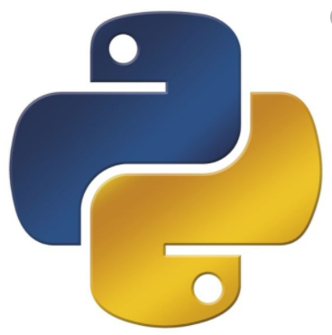
Python Programming
(Business & Analytics)
by Su Lee Seng,
Jan, 2021

Slide 2
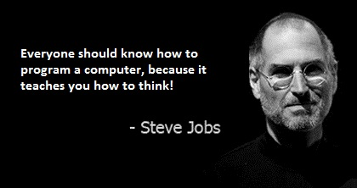
Python Programming
(Business & Analytics)
by Su Lee Seng,
Jan, 2021

Slide 3
Talk is cheap.
show me the code.

Slide 4
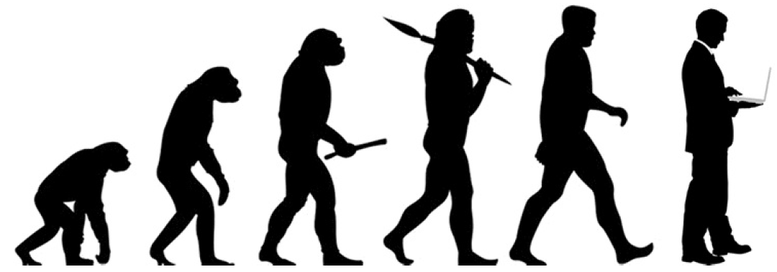
SAP HANA – An Introduction
@ UTAR
by Su Lee Seng,
April, 2014.

Slide 5
Python Programming
Introduction

Slide 6
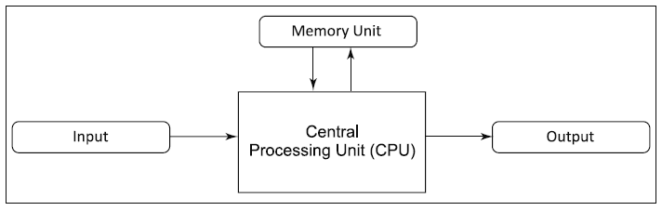
Python Programming – Introduction :
What is a Computer
The word computer is derived from ‘compute’, which means ‘to calculate’.

Slide 7
Python Programming – Introduction :
Memory Unit
The function of the memory unit is to store programs and data. The unit is a compilation of numerous storage cells and each cell can store one bit of information. These cells are processed in a group of fixed sizes of units called words and they never read or write as individual cells.

Slide 8
Python Programming – Introduction :
Memory Unit
A computer’s memory system can be divided into the following three groups:
1. Internal memory: It refers to the set of registers confined to the CPU. These registers hold temporary results when a computation is in progress.
2. Primary memory: It is a storage area in which all the programs are executed. All programs and data must be stored in the primary memory for speedy execution.
3. Secondary memory: It is known as external memory or storage memory. Programs and data are stored here for the long term. Hard disk, floppy disk, CDs, DVDs and magnetic tapes are different forms of secondary memory.

Slide 9
Python Programming – Introduction :
Overview of Programming Languages
A computer program is a set of instructions, which performs a specific task when executed by a computer. Computer programs are commonly known as software. The instructions in a program tell a computer what to do and these instructions can be written in three types of programming languages.

Slide 10
Python Programming – Introduction :
Overview of Programming Languages
Machine Language
A computer is an electronic machine which can understand any instruction written in binary form, i.e. using only 0s and 1s. A program written in 0s and 1s is called machine language. While a computer easily understands this language, it is difficult for humans to write an instruction in terms of 0’s and 1’s.
Example
A series of numbers, such as 0011, 1000, 1010 is an instruction written in machine language. The instruction implies addition of a number stored at location 8 (1000) and another number stored at location 10 (1010) and storing the result at location 8 (1000). Here, the binary code 0011 stands for addition.

Slide 11
Python Programming – Introduction :
Overview of Programming Languages
Assembly Language
It is difficult to write, read, communicate or change a program written in machine language for humans. Hence, the need to create another more convenient language arose. In assembly language, which was developed subsequently, machine operations are represented by mnemonic codes (such as ADD and MUL) and symbolic names that specify the memory address. Consider the following example.
Example
MOV X, 10
MOV Y, 20
ADD X, Y
Since computers cannot understand the assembly language, a program called assembler is used to translate assembly language programs into equivalent machine language programs.

Slide 12
Python Programming – Introduction :
Overview of Programming Languages
High-level Language
High-level languages are much easier to write than low-level languages because programs written in these are similar to instructions written in the English language. Here ‘high’ does not imply that the language is complicated. It means that the language is more problem oriented.
Generally, high-level languages are platform independent. This means that one can write a program in a high-level language and run it on different types of machines.
Instructions written in high-level languages are called statements.
For example, a statement to calculate the square of a number can be written in a high-level language as
Square = number * number
There are many high-level languages and the selection of a language is based on the purpose it is expected to fulfill. A program written in a high-level language is called source code or source program.

Slide 13
Python Programming – Introduction :
Overview of Programming Languages
For example, a statement to calculate the square of a number can be written in a high-level language as
Square = number * number
There are many high-level languages and the selection of a language is based on the purpose it is expected to fulfill. A program written in a high-level language is called source code or source program.

Slide 14
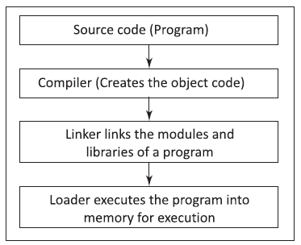
Python Programming – Introduction :
Execution of High-level Language Program
Steps to execute a high-level language program

Slide 15
Python Programming – Introduction :
Compiler-Interpreter-Linker-Loader
Compiler
It is a software that translates a program written in a high-level language into machine language.
This compiled program is called object code. The object code is an executable code which can run as a standalone code, i.e. it does not need the compiler to be present during execution. Every programming language, such as C, C++ and Java has its own compiler.
Interpreter
While a compiler converts the whole source code into an equivalent object code or machine code, the interpreter reads the source code line by line and converts it into object code (i.e. a code understandable to the machine.

Slide 16
Python Programming – Introduction :
Compiler-Interpreter-Linker-Loader
Linker
It is a program that links different program modules and libraries to form a single executable program. A source code of a program is very large. It can consist of hundreds of lines of code. Before the execution of a program, all the modules of the program and the required libraries are linked together using a software called a linker. The compiled and linked program is called the executable code.
Loader
This software is used to load and relocate an executable program in the main memory during execution. The loader assigns a storage space to a program in the main memory for execution.

Slide 17
Python Programming
First Python Program

Slide 18
Python Scripts & Modules :
Python Programs
Most Python code lives in text files with a .py extension. These files are simply plain text and can be edited with any text editor. Programmers typically edit these files using either a text editor such as Notepad++, or Integrated Development Environments (IDEs) such as Jupyter or PyCharm.
Typically, standalone .py files are either called scripts or modules. A script is a file that is designed to be executed, usually from the command line. On the other hand, a module is usually imported into another part of the code or an interactive shell to be executed.
Note that this is not a hard distinction; modules can be executed, and scripts can be imported into other scripts/modules.

Slide 19
Python Scripts & Modules :
Exercise 1: Writing and Executing Our First Script
In this exercise, you will create a script called y_script.py and execute it on the command line. You will be then finding the sum of the factorials of three numbers:
1. Using your favorite text editor, create a new file called my_script.py. You can also use Jupyter (New | Text File).
2. Import the math library:
import math
3. Suppose that you had a list of numbers and you wanted to print the sum of the factorials of these numbers. Recall that a factorial is the product of all the integers up to and equal to a given number.

Slide 20
Python Scripts & Modules :
Exercise 2: Writing and Executing Our First Script
For instance, the factorial of 5 is calculated as 5! = 5 * 4 * 3 * 2 * 1 = 120.
In the following code snippet, you are going to find the sum of factorials of 5,7 and 11.
numbers = [5, 7, 11]
4. Using the math.factorial function and list comprehension, compute and print result:
result = sum([math.factorial(n) for n in numbers])
print(result)

Slide 21
Python Scripts & Modules :
Exercise 2: Writing and Executing Our First Script
5. Save the file.
6. Open a Terminal or a Jupyter Notebook and ensure that your current directory is the same as the one with the my_script.py file. To check this, if you run dir in the Terminal, you should see my_script.py in the list of files. If not, navigate to the correct directory using the cd command.
7. Run python my_script.py to execute your script.
You should get the following output:
39921960
In this exercise, you successfully created and executed a file by navigating to the correct directory from the Terminal or Jupyter Notebook.

Slide 22
Python Scripts & Modules :
Exercise 2: Writing and Importing Our First Module
In this exercise, as in Exercise 34, Writing and Executing Our First Script, you will be finding the factorials of three numbers. However, you will now create a module called my_module.py, and import it into a Python shell:
1. Using your favorite text editor, create a new file called my_module.py. You can also use Jupyter (New | Text File).
2. Add a function that prints the result of the computation in Exercise 34, Writing and Executing Our First Script. You will learn more about this function notation in the upcoming section on basic functions:
import math
def compute(numbers):
return([math.factorial(n) for n in numbers])

Slide 23
Python Scripts & Modules :
Exercise 2: Writing and Importing Our First Module
3. Save the file.
4. Open a Python shell or Jupyter Notebook and execute the following:
from my_module import compute
compute([5, 7, 11])
You should get the following output:
[120, 5040, 39916800]

Slide 24
Python Scripts & Modules :
Exercise 2: Writing and Importing Our First Module
Note
Writing this code as a module is useful if you want to reuse our welcome function in another script or module. However, if you just want to execute the print statement once, and you don't want to have to import our function to a shell, the script is more convenient.
In this exercise, you created a module file called my_module.py and imported this module file to get the expected output on Jupyter or the Python shell.

Slide 25
Python Programming – A First Python Program :
Hello World
Using any of these tools we can create file with a .py extension. Such a file can contain one or more Python statements that represent a Python program or Script.
For example, we can create a file called hello.py containing the above print() function in it.
If you are running it from the command line type in python followed by the name of the file, for example:
> python hello.py
This should be done in the directory where you created the file.

Slide 26
Python Programming – A First Python Program :
A more interesting…Hello World
The updated program is:
print('Hello, world')
user_name = input('Enter your name: ')
print('Hello ', user_name)
Output :
Hello, world
Enter your name: Lee
Hello Lee

Slide 27
A First Python Program - A First Python Program :
Comments in Code
It is common practice (although not universally so) to add comments to code to help anyone reading the code to understand what the code does, what its intent was, any design decisions the programmer made etc.
Comments are sections of a program that are ignored by the Python interpreter- they are not executable code.
A comment is indicated by the '#' character in Python.
# This is a comment
name = input('Enter your name: ')
# This is another comment
print(name) # this is a comment to the end of the line
<< Exercise B03 >>
Notes:
In the above, the two lines starting with a # are comments—they are for our human eyes only. Interestingly the line containing the print() function also has a comment—that is fine as the commend starts with the # and runs to the end of the line, anything before the # character is not part of the comment.

Slide 28
Python Programming – A First Python Program :
Comments in Code
When the Python interpreter sees #, it ignores all the text after # on the same line. Similarly, when it sees the triple quotation marks ‘’’ it scans for the next ‘’’ and ignores any text in between the triple quotation marks.
The following program demonstrates the use of comment statements in Python.
#Learn How to Comment in python
print(‘I Learnt How to Comment in Python’)
‘’’ Amazing tool
in Python called Comment’’’
print(‘Bye’)
Output :
I Learnt How to Comment in Python
Bye

Slide 29
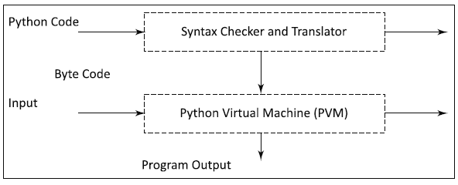
Python Programming – A First Python Program :
Internal Working of Python
Step 1: The interpreter reads a Python code or instruction. Then it verifies that the instruction is well formatted, i.e. it checks the syntax of each line. If it encounters any error, it immediately halts the translation and shows an error message.

Slide 30
Python Programming – A First Python Program :
Internal Working of Python
Step 2: If there is no error, i.e. if the Python instruction or code is well formatted then the interpreter translates it into its equivalent form in low level language called “Byte Code”. Thus, after successful execution of Python script or code, it is completely translated into byte code.
Step 3: Byte code is sent to the Python Virtual Machine (PVM). Here again the byte code is executed on PVM. If an error occurs during this execution then the execution is halted with an error message.

Slide 31
Python Programming – A First Python Program :
A more interesting…Hello World
user_name = input('Enter your name: ')
This statement does several things. It first executes another function called input(). This function is passed a string - which is known as an argument – to use when it prompts the user for input.
This function input(), is again a built-in function that is part of the Python language. In this case it will display the string you provide as a prompt to the user and wait until the user types something in followed by the return key.

Slide 32
First Python Program
Variables

Slide 33
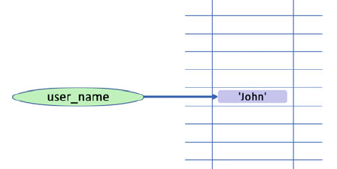
Python Programming – A First Python Program :
A Variable
A variable is a named area of the computers’ memory that can be used to hold things (often referred to as data) such as strings, numbers, boolean such as True/ False etc

Slide 34
Python Programming – A First Python Program :
A Variable
A variable, such as user_name, can reference an area of memory containing actual data. In this diagram the memory is shown as a two dimensional grid of memory locations. Each location has an address associated with it. This address is unique within the memory and can be used to return to the data held at that location. This address is often referred to as the memory address of the data.
It is this memory address that is actually held in the variable user_name; this is why the user_name variable is shown as pointing to the area in memory containing the string 'John'.
Thus the variable user_name allows us to access this area of memory easily and conveniently.

Slide 35
Python Programming – A First Python Program :
Print
print('Hello', user_name)
The last statement again uses the built-in print() function, but this time it takes two arguments. This is because the print() function can actually take a variable number of arguments (data items that we pass into it).
Each argument is separated by a comma. In this case we have passed in the string 'Hello' and whatever value is referenced by (present at the memory address indicated by) the variable user_name.

Slide 36
A First Python Program - Variables :
Variables
You may wonder why the element holding the user’s name above is referred to as a variable. It is a called a variable because the value it references in memory can vary during the lifetime of the program.
print('Hello, world')
name = input('Enter your name: ')
print('Hello', name)
name = input('What is the name of your best friend: ')
Print('Hello Best Friend', name)
If we want to, we can reuse the variable to hold the name of that best friend.

Slide 37
A First Python Program - Variables :
Variables
Output :
Hello, world
Enter your name: John
Hello John
What is the name of your best friend: Denise
Hello Best Friend Denise
You may wonder why the element holding the user’s name above is referred to as a variable. It is a called a variable because the value it references in memory can vary during the lifetime of the program.
print('Hello, world')
name = input('Enter your name: ')
print('Hello', name)
name = input('What is the name of your best friend: ')
Print('Hello Best Friend', name)
If we want to, we can reuse the variable to hold the name of that best friend.
Notes:
As you can see from this when the string 'Hello Best Friend' is printed, it is the name 'Denise' that is printed alongside it.
This is because the area of memory that previously held the string 'John' now holds the string 'Denise'.

Slide 38
A First Python Program - Variables :
Variables
my_variable = 'John'
print(my_variable)
my_variable = 42
print(my_variable)
my_variable = True
print(my_variable)
As you can see my_variable first holds (or references the area of memory containing) the string 'John', it then holds the number 42 and finally it holds the Boolean value True (Boolean values can only be True or False).
Output :
John
42
True

Slide 39
A First Python Program - Variables :
Naming Conventions - Variables
Both these variable names highlight a very widely used naming convention in Python, which is that variable names should:
Is a sequence of characters that consists of letters, digits and underscore
    Can be of any length
    Starts with a letter which can be either lower or upper case → be all lowercase (good practices)
    Can start with an underscore ‘_’
    Cannot start with a digit
    Cannot be a keyword.

Slide 40
A First Python Program - Variables :
Naming Conventions - Variables
Can be in general more descriptive than variable names such as a or b (although there are some exceptions such as the use of variables i and j in looping constructs).
    • Can be with individual words separated by underscores as necessary to improve readability.
This last point is very important as in Python (and most computer programming languages) spaces are treated as separators which can be used to indicate where one thing ends and another starts.

Slide 41
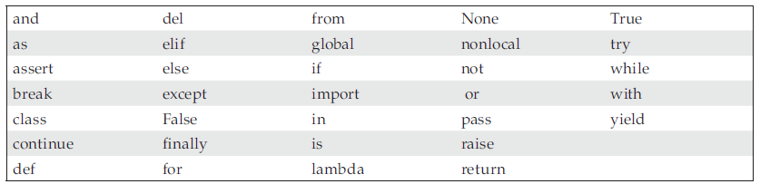
A First Python Program - Variables :
Naming Conventions - Keywords
xx

Slide 42
A First Python Program - Variables :
Naming Conventions - Variables
Thus it is not possible to define a variable name such as:
• user name
As the space is treated by Python as a separator and thus Python thinks you are defining two things 'user' and 'name'.
When you create your own variables, you should try to name then following the Python accepted style thus name such as:
• my_name, your_name, user_name, account_name
• count, total_number_of_users, percentage_passed, pass_rate
• where_we_live, house_number,
• is_okay, is_correct, status_flag

Slide 43
A First Python Program - Variables :
Naming Conventions - Variables
The following variable names do not meet the accepted conventions.
• A, Aaaaa, aaAAAaa
• Myname, myName, MyName or MYName
• WHEREWELIVE
However, it is worth mentioning that these are merely commonly adhered to conventions.

Slide 44
A First Python Program - Variables :
Assignment Operator
user_name = input('Enter your name: ')
It is called the assignment operator. It is used to assign the value returned by the function input() to the variable user_name. It is probably the most widely used operator in Python. Of course, it is not just used to assign values from functions …
For example, we also used it when we stored a string into a variable directly:
my_variable = 'Jason'
my_variable = 42

Slide 45
A First Python Program - Variables :
Python Statements
In Python a statement is an instruction that the Python interpreter can execute. This statement may be formed of a number of elements such as the one above which includes a call to a function and an assignment of a value to a variable. In many cases a statement is a single line in your program but it is also possible for a statement to extend over several lines particularly if this helps the readability or layout of the code.

Slide 46
A First Python Program - Variables :
Python Statements
For example, the following is a single statement but it is laid out over 6 lines of code to make it easier to read:
print('The total population for’,
city,
'was',
number_of_people_in_city,
'in’,
year)
Is the same as ….
print('The total population for’, city,'was', number_of_people_in_city, 'in’, year)

Slide 47
A First Python Program - Variables :
Python Statements
As well as statements there are also expressions. An expression is essentially a computation that generates a value, for example:
4 + 5
This is an expression that adds 4 and 5 together and generates the value 9.

Slide 48
A First Python Program - Variables :
Online Resources
See the Python Standard Library documentation for:
• https://docs.python.org/3/reference/simple_stmts.html For information on statements in Python.

Slide 49
Thank you

